Slide 1

Analysis of textual similarities and key terms in songs
Purpose: analyze textual similarity and key terms in three songs (Russian language)
Tasks include computing TF-IDF and comparing vectorization methods
Dataset consists of 3 manually provided song lyrics
Methods applied: TF-IDF, CountVectorizer, Word2Vec, Doc2Vec
Final goal: determine most and least common terms across songs

Slide 2

Data preparation
Imported three Russian-language song lyrics as raw text
Stored texts in a list structure for vectorization
Applied basic text preprocessing (implicit from vectorizer defaults)
Prepared corpus for scikit-learn and gensim models
Ensured support libraries installed (e.g., gensim for Word2Vec/Doc2Vec)

Slide 3
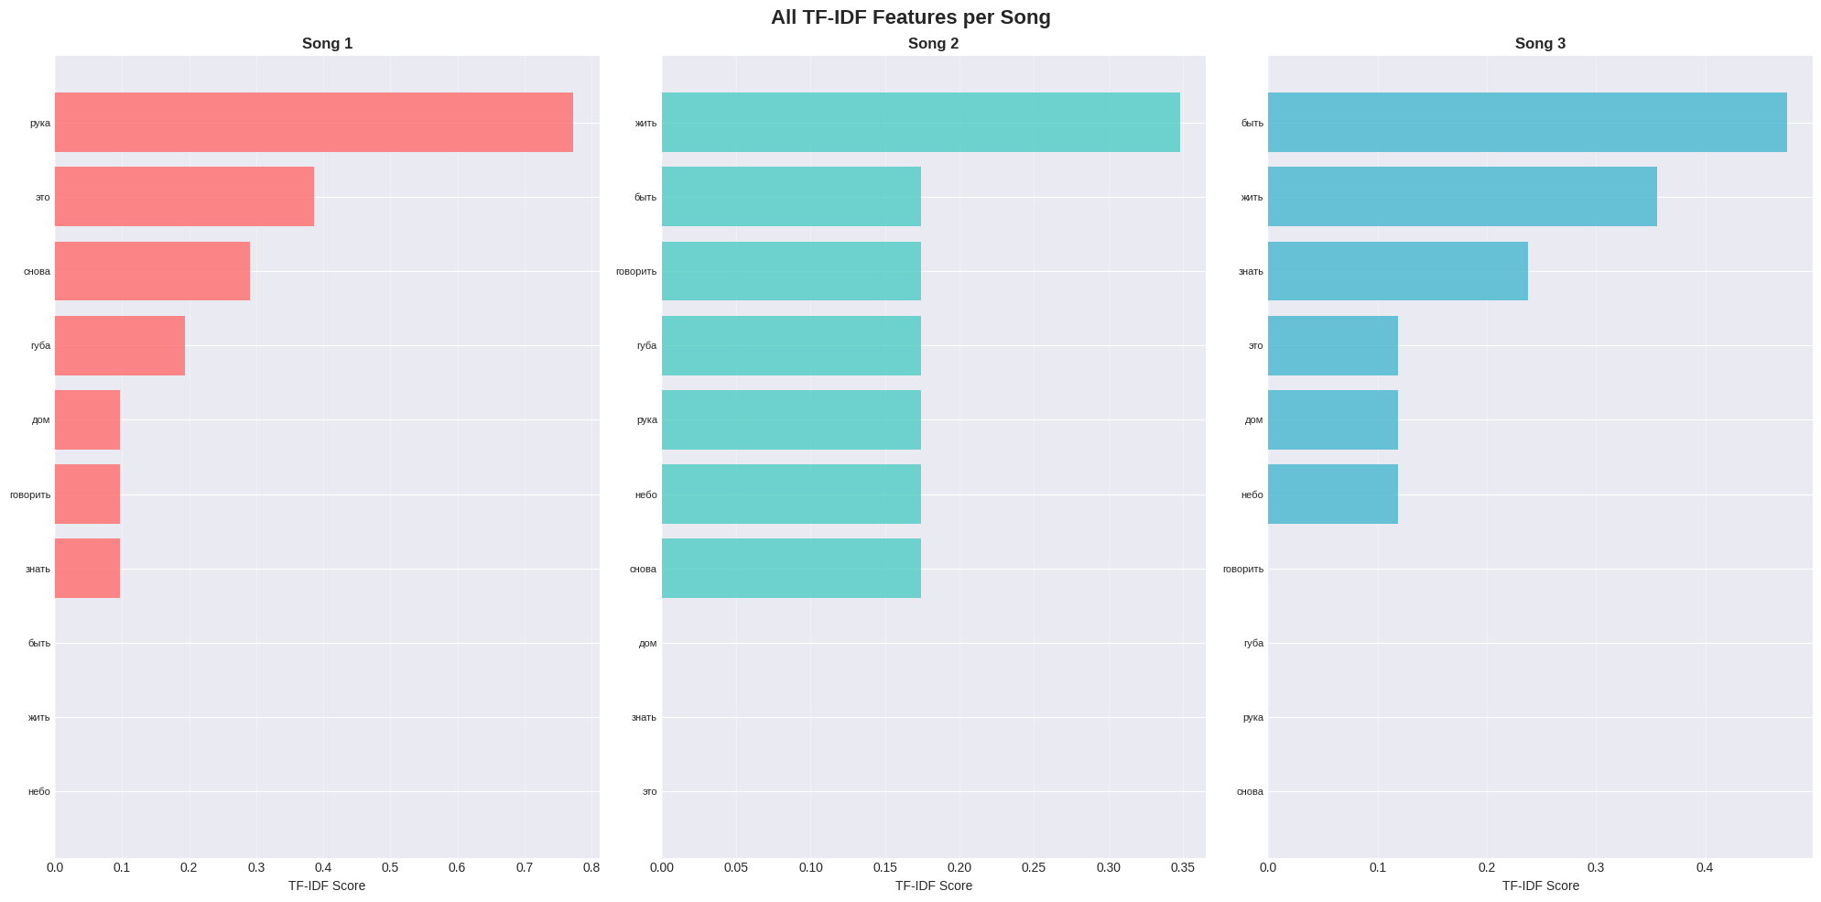
TF-IDF vectorization
Apply TfidfVectorizer
Мatrices TF-IDF
Identified words with highest TF-IDF values as context-specific terms
Applied TfidfVectorizer to compute term weights for all three songs
Produced TF-IDF matrices representing term importance per song
Enabled comparison of lyric uniqueness between songs

Slide 4
Comparison of vectorization methods
CountVectorizer
TF-IDF
Count-based representation capturing raw word frequency
Normalized counts emphasizing unique, informative words
Word2Vec
Doc2Vec
Learned word embeddings capturing semantic similarity
Sentence/paragraph embeddings representing each full song
Compared representations by dimensionality, semantic depth, and sparsity

Slide 5
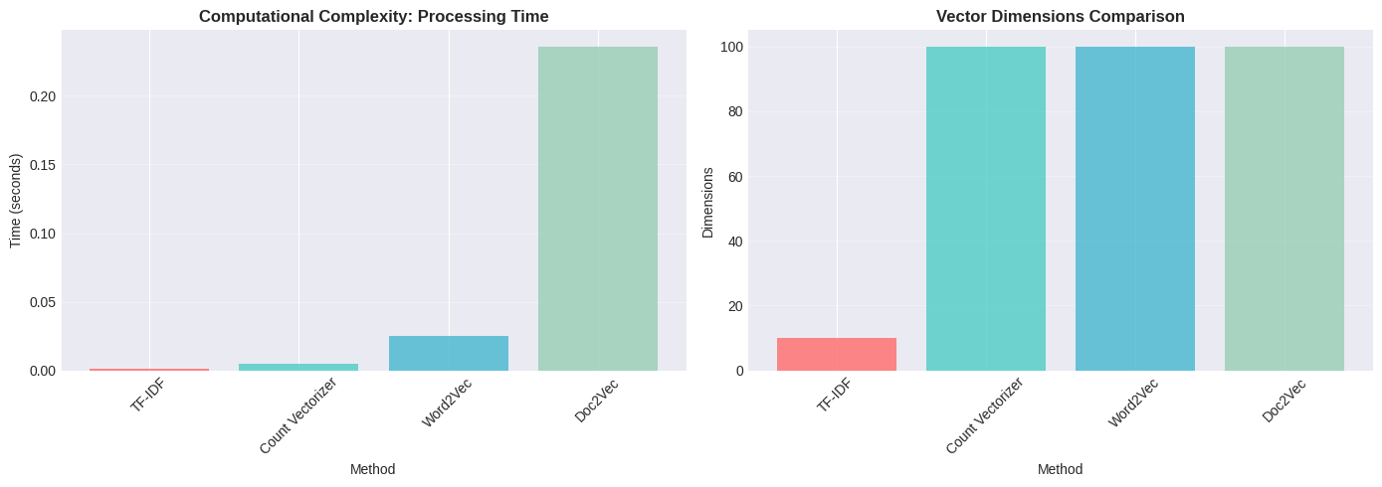
Semantic modeling(Word2Vec & Doc2Vec)
Trained custom Word2Vec model on all three songs combined
Generated continuous embedding vectors for each word
Doc2Vec used to compute vector representation per song (document-level)
Models allowed measuring semantic similarity beyond simple frequency
Highlighted contextual relationships among emotionally similar terms

Slide 6
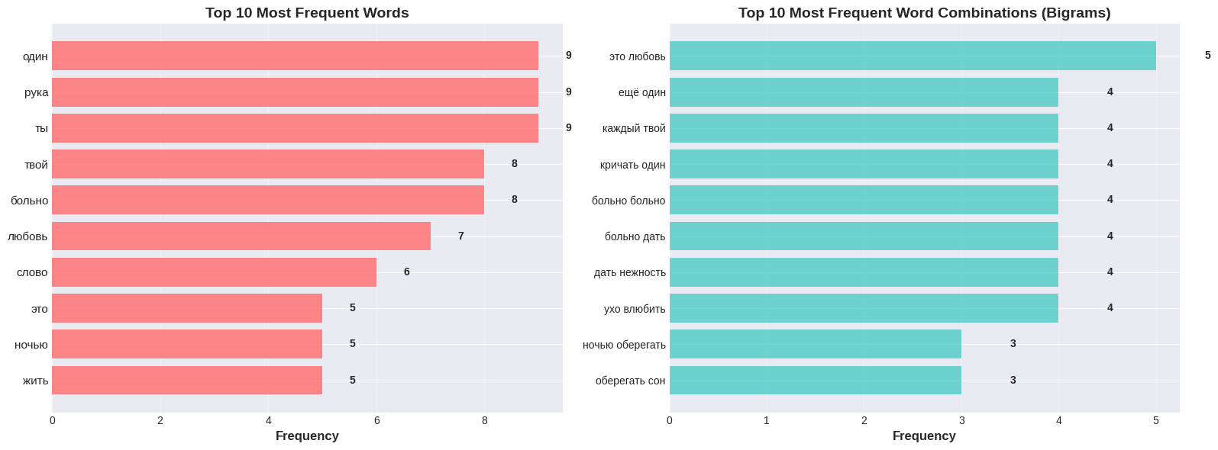
Analysis of frequency and importance of terms
Most common words
Thematic intersections
Identified most common words using CountVectorizer term counts
Observed thematic overlaps: love, emotion, personal reflection
Unique words
Semantic clusters
TF-IDF revealed distinct song-specific words (e.g., персональные эмоции, образы)
Found semantic clusters via Word2Vec around “любовь”, “влюблён”, etc.
Least frequent words
Least common terms often linked to unique narrative details

Slide 7
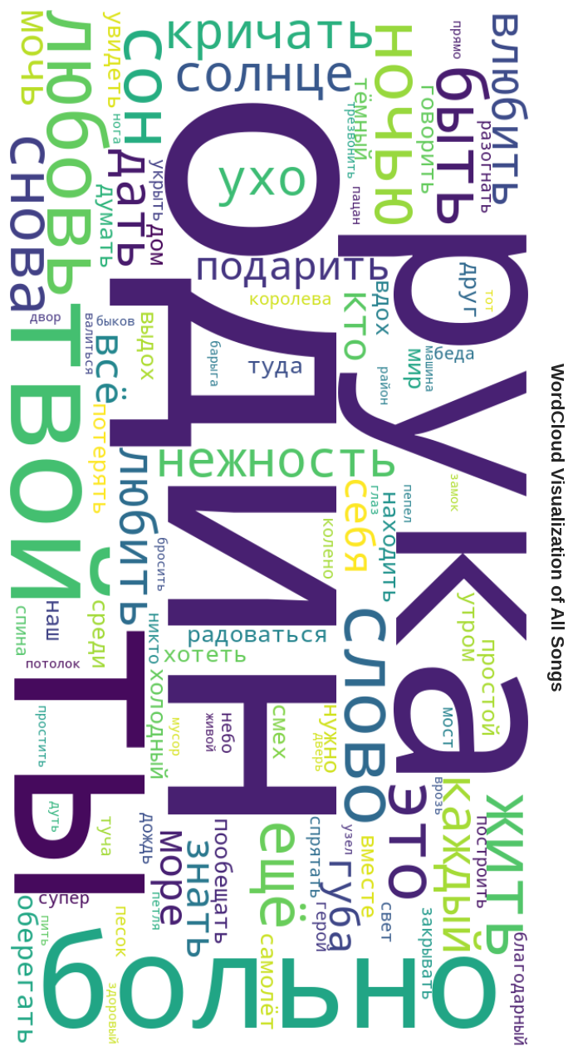
Conclusion
Successfully calculated TF-IDF
1
Successfully calculated TF-IDF and compared with alternative vectorizers
Complementary insights
2
Count-based vs. embedding-based models provide complementary insights
Highlighted distinctive terms
3
TF-IDF best highlighted distinctive terms across songs
Deeper semantic coherence
4
Word2Vec/Doc2Vec captured deeper semantic coherence
Dominant theme and unique vocabulary
5
Analysis revealed both dominant themes and unique vocabulary in each song

Slide 8

Movie Review Sentiment Classification with BERT

Slide 9
Introduction
Goal: apply a pre-trained BERT model for sentiment classification of movie reviews
Dataset: IMDB movie reviews loaded from CSV
Task type: binary classification (positive vs. negative sentiment)
Frameworks used: PyTorch, HuggingFace Transformers
Workflow includes preprocessing, model fine-tuning, evaluation, and inference

Slide 10
Data Preparation
01
02
03
Loaded IMDB dataset from Google Drive
Cleaned dataset and prepared text–label pairs
Downloaded NLTK stopwords and tokenizers
04
05
Split data into train and test sets
Applied BERT tokenizer to convert text into token IDs and attention masks

Slide 11

Model Setup
Loaded a pre-trained BERT base model with a classification head
Set up device configuration (CPU/GPU) for training
Fixed random seeds to ensure reproducibility
Created custom PyTorch Dataset and DataLoader objects
Defined batch size (16) and training hyperparameters

Slide 12





Training Pipeline
Optimizer: AdamW
with standard BERT learning rate (2e-5)
Scheduler
linear learning-rate decay with warm-up
Trained model for 2 epochs
For each batch
forward pass → loss computation → backward pass → weight update
Saved model checkpoint
with best F1-score during training

Slide 13
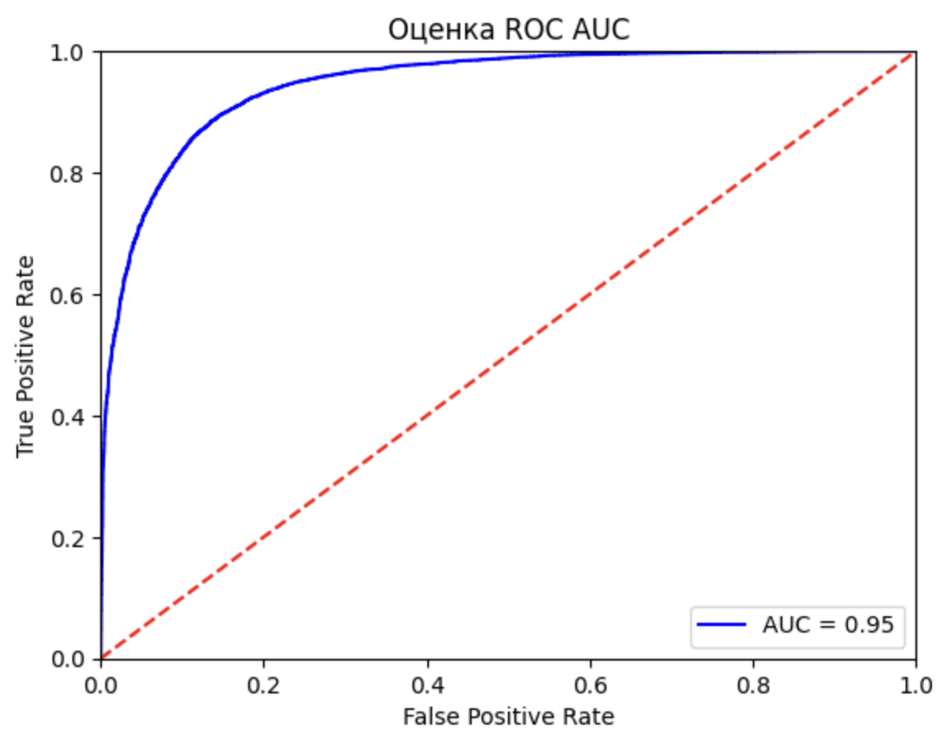
Evaluation
Set model to evaluation mode, disabled gradient computation
Collected predictions and true labels across the test set
Computed classification metrics:
Accuracy
Precision, Recall
F1-score (main metric used to select best model)
Generated a complete classification report

Slide 14
Inference Example
Implemented a function to classify a single review
Tokenized new text and ran it through the fine-tuned BERT model
Output included:
Demonstrated how the trained model handles real input
Predicted class label
Positive/negative probabilities
Inference time

Slide 15

Conclusion
Successfully fine-tuned a pre-trained BERT model on IMDB movie reviews
Achieved strong performance using standard transformer-based workflow
Key strengths: contextual embeddings, robust tokenization, strong generalization
Pipeline supports both model evaluation and practical inference
Approach can be extended to other sentiment or text-classification tasks

